Slide 1
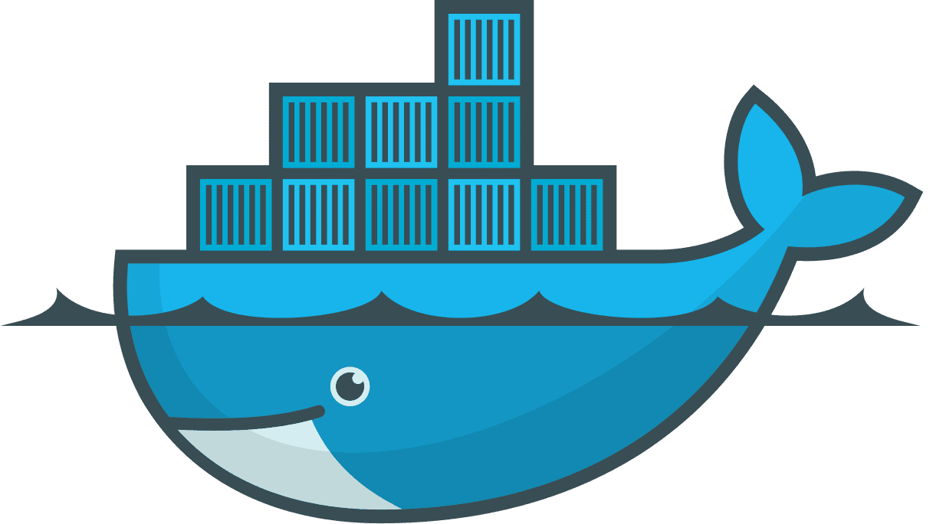
Introduction to Docker
Drafted by - Aadesh Shrivastava
aadesh.shrivastava@infosys.com

Slide 2
Agenda
Why we need Docker?
What is Docker?
Docker Platform
Docker File

Slide 3
Agenda
How containers are created?
Docker Command Cheat sheet

Slide 4
Why we need Docker?

Slide 5



Problems Before Docker
An application works in developer’s laptop but not in testing or production. This is due to difference in environments between Dev, Test and Prod.
Code works fine in my Laptop
There is some problem with the code
In Dev there can be a software that is upgraded and in Prod the old version of software might be present.
Dev
Prod

Slide 6
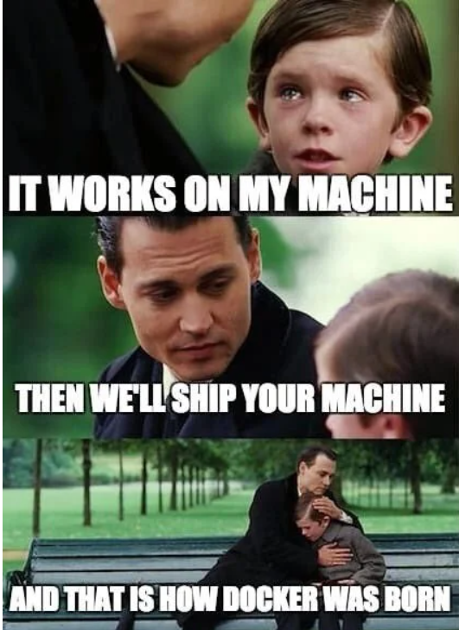
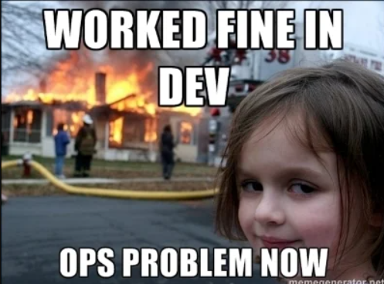
Problems Before Docker

Slide 7
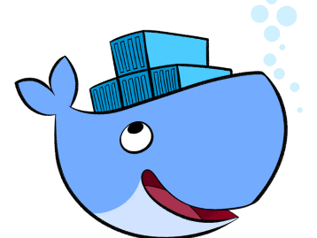
How Docker solves these problems
You can run several Microservices in the same VM by running various Docker containers for each Microservices.
Virtual Machine for starting multiple Microservices
In Dev there can be a software that is upgraded and in Prod the old version of software might be present.
Developer’s Laptop

Slide 8
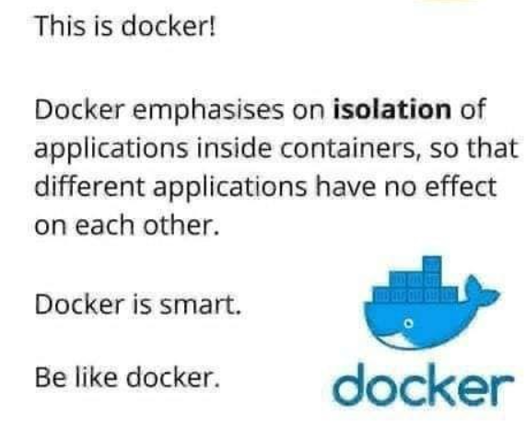
How Docker solves these problems

Slide 9
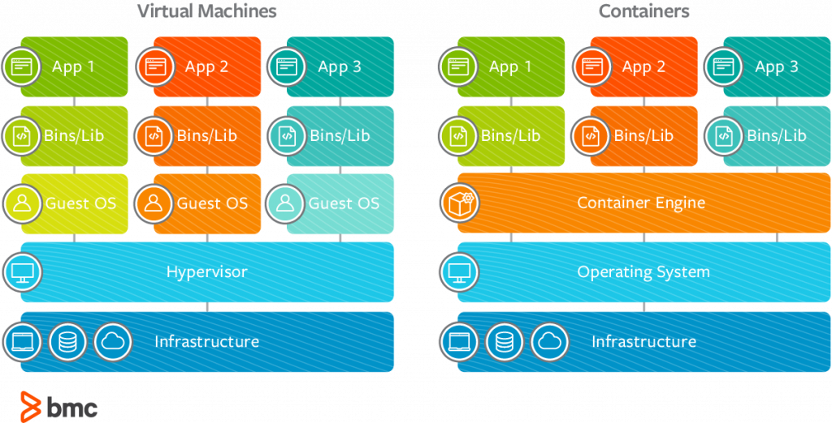
Docker vs Virtual Machines

Slide 10
Why Docker?
Isolation
Lightweight
Simplicity
Workflow

Slide 11
What is Docker?

Slide 12

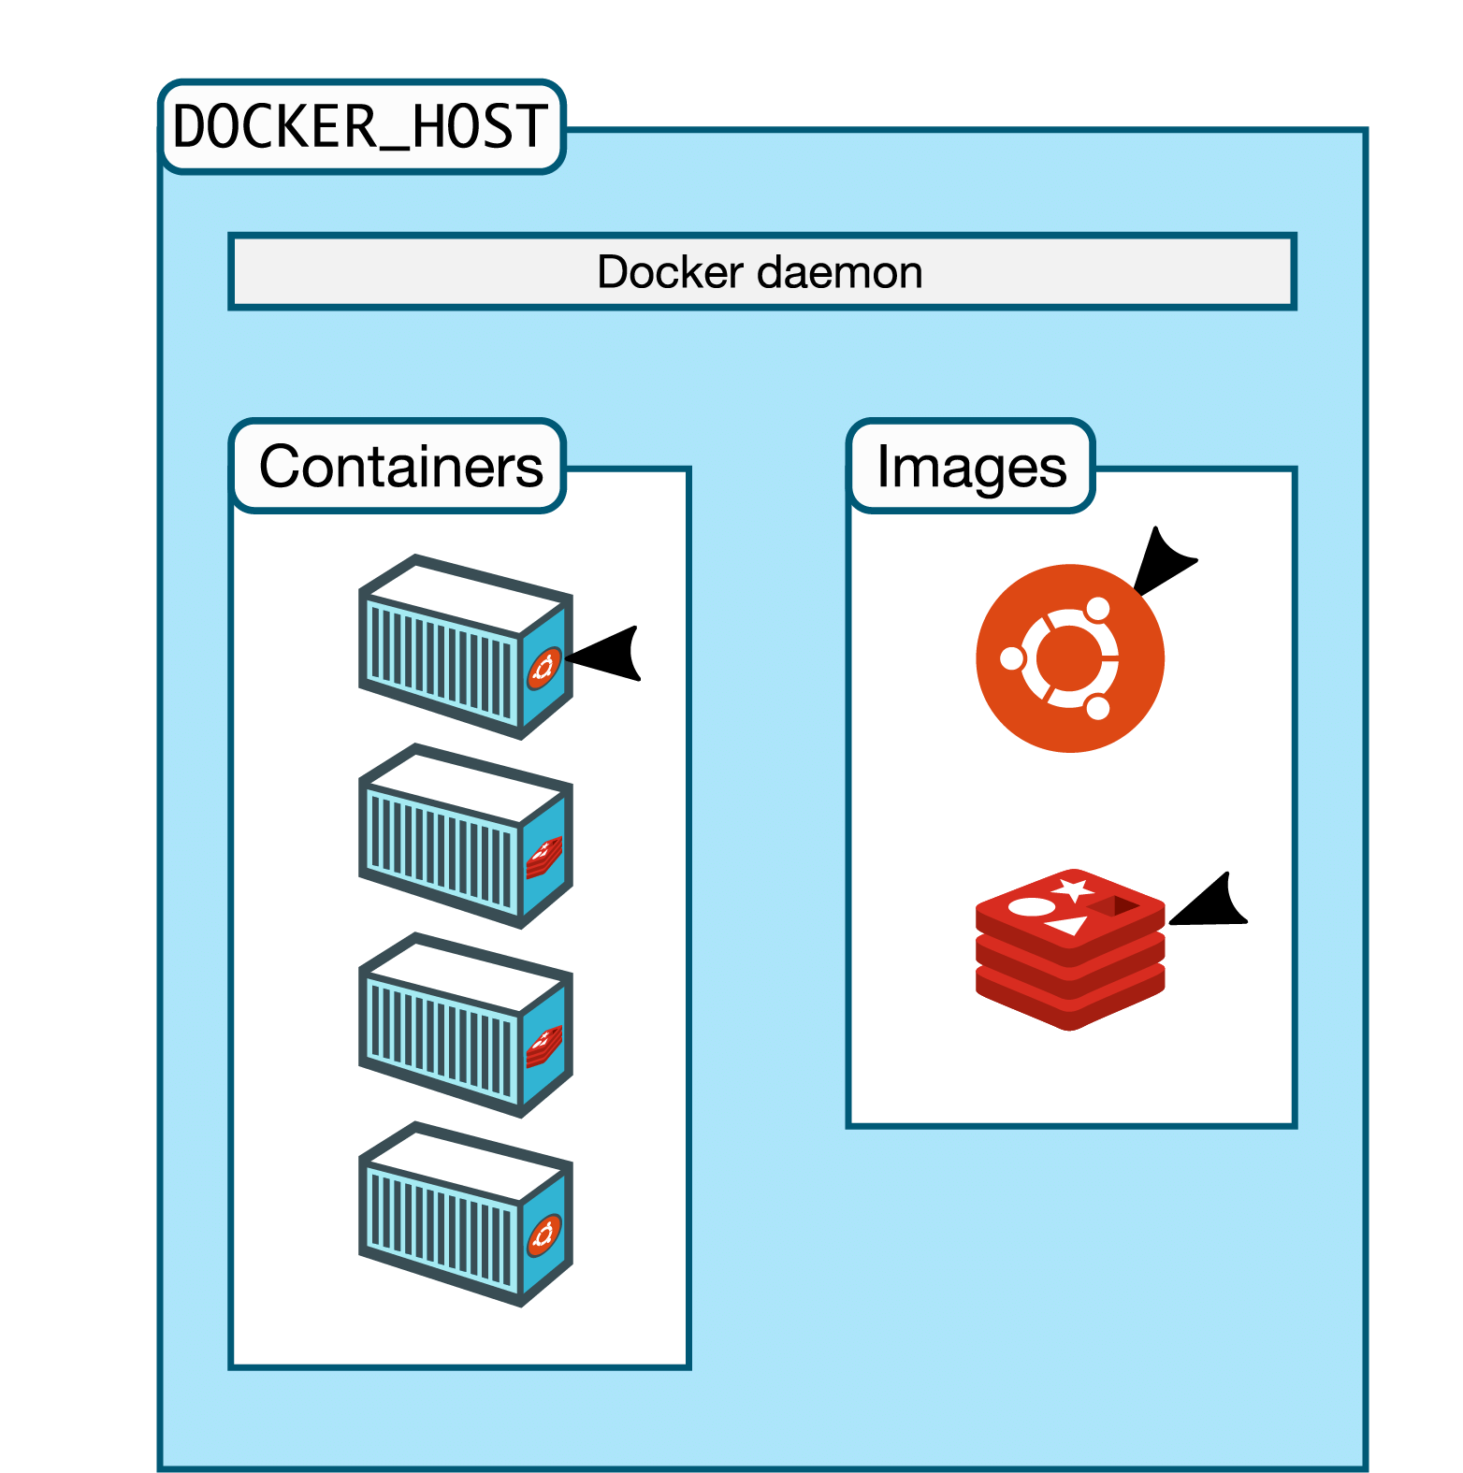
What is Docker?
Docker is a tool designed to make it easier to create, deploy, and run applications by using containers.
Docker containers are lightweight alternatives to Virtual Machines and it uses the host OS.
You don’t have to pre-allocate any RAMS in containers.

Slide 13
Docker in a Nutshell
In simplest terms, Docker containers consist of applications and all their dependencies.
They share the kernel and system resources with other containers and run as isolated systems in the host operating system.
The main aim of Docker containers is to get rid of the infrastructure dependency while deploying and running applications.
Technically, they are just the runtime instances of Docker images.

Slide 14
Docker Platform

Slide 15
Docker Engine
+Docker Hub
=Docker Platform
_________________

Slide 16
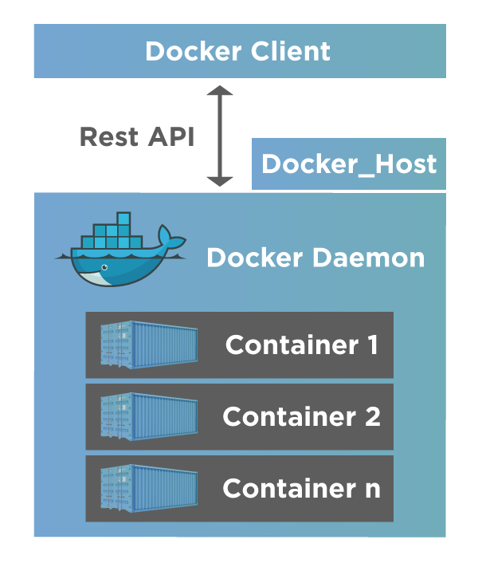
Docker Engine
The software that hosts the containers is named Docker Engine.
Docker Engine is a Client – Server based application.
A Client or a Command Line Interface (CLI).
Docker Engine has a daemon process that acts as a server. A Docker daemon is a background process. The daemon process is responsible for managing images, containers, storage volumes, and networks.
Docker Engine

Slide 17
Docker Engine
Docker Daemon
Docker CLI

Slide 18
Docker Daemon
Builds Images
Runs and Manages Containers
RESTful API

Slide 19
Docker CLI
docker build #Build an image from a Docker file
docker images #List all images on a Docker host
docker run #Run an image
docker ps #List all running containers
docker stop #Stop a running Docker Instances
docker rm #Remove an instance
docker rmi #Remove an image

Slide 20
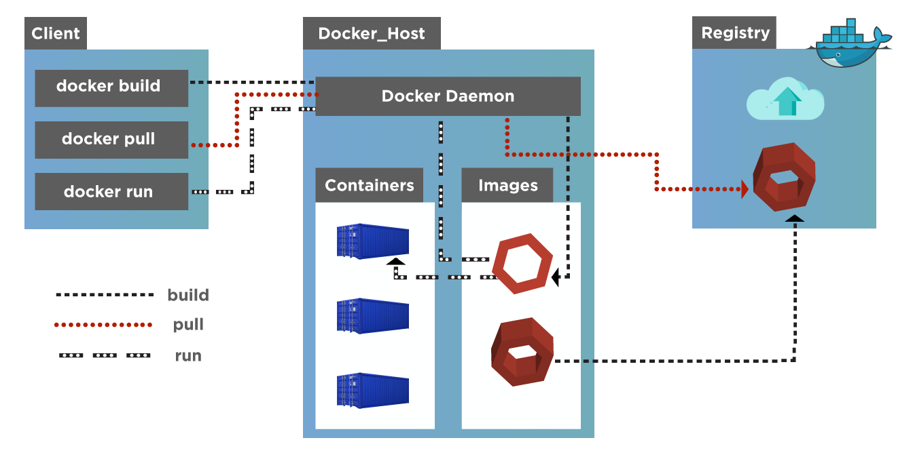
Docker Architecture

Slide 21
Docker Architecture
Docker Client : client triggers interactions with the Docker Host
Docker Host : Docker host runs a Docker daemon and a docker registry
The Docker Daemon : is a component that runs inside the Docker Host and handles the images and containers.
Docker registry : The docker registry stores the docker images. Docker hub is one such registry, but you can have your own too.

Slide 22
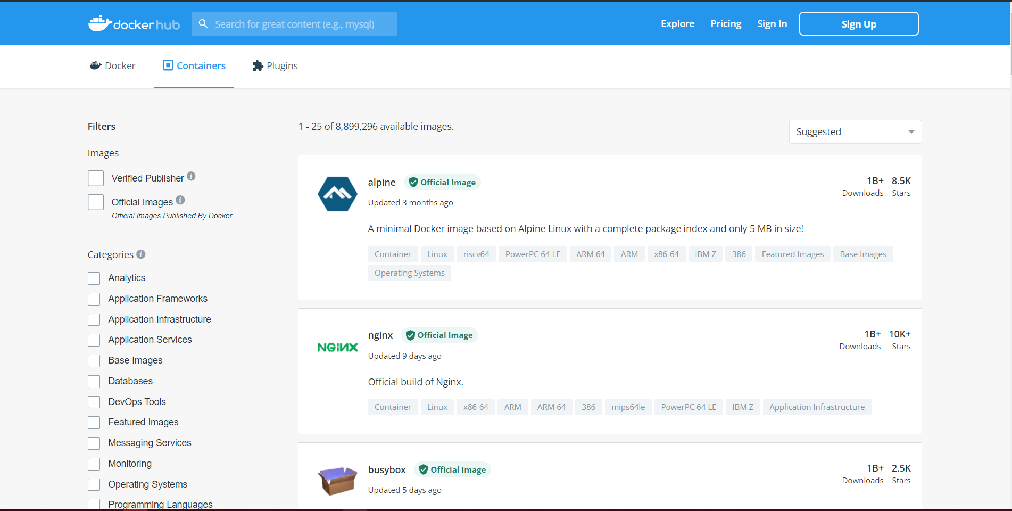
Docker Hub

Slide 23
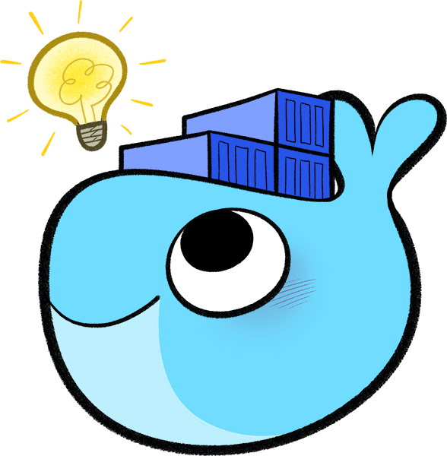
Docker Hub
Provides Docker Services
Library of public images
Storage for your images
Automated builds (link github/bitbucket repo; trigger build on commit)
Basically, It’s a public cloud-based registry provided by Docker for storing public images of the containers along with the provision of finding and sharing them.

Slide 24
Docker File

Slide 25
Docker File
It is a text document that contains necessary commands which on execution helps assemble a Docker Image.
Docker image is created using a Docker file.

Slide 26
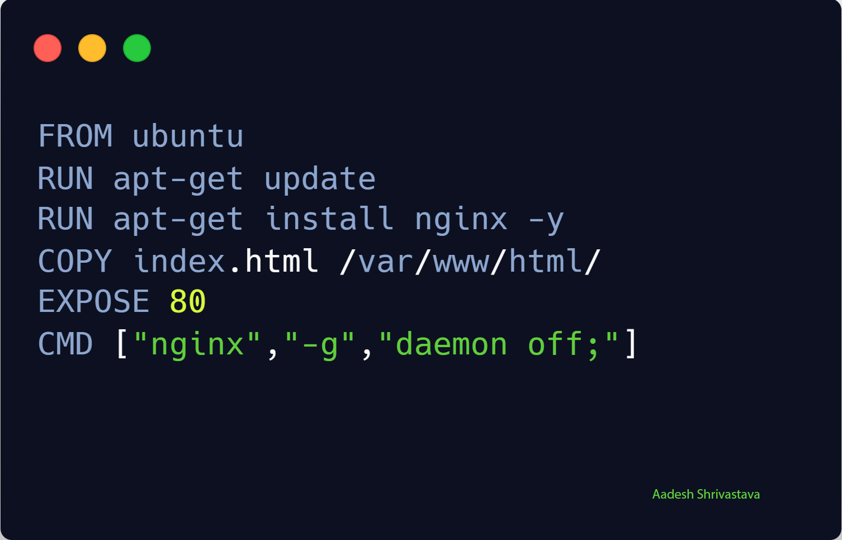
How to write a Docker File

Slide 27
How to write Docker File Contd…
FROM — is where we are pulling our official image from ubuntu is an official image provided by Docker
WORKDIR — you guessed it…it is setting the current location (directory) of where are files are located(not used here but an option for your future use)
RUN — provides an instruction to download and acquire all packages updates from the internet
RUN — the next run instruction install nginx web server on our container

Slide 28
How to write Docker File Contd…
COPY — adds files from your Docker client’s current directory
EXPOSE — is a documentation instruction letting the container know we are exposing the standard port 80 (TCP)
CMD — provide defaults for an executing container

Slide 29
How containers are created?

Slide 30
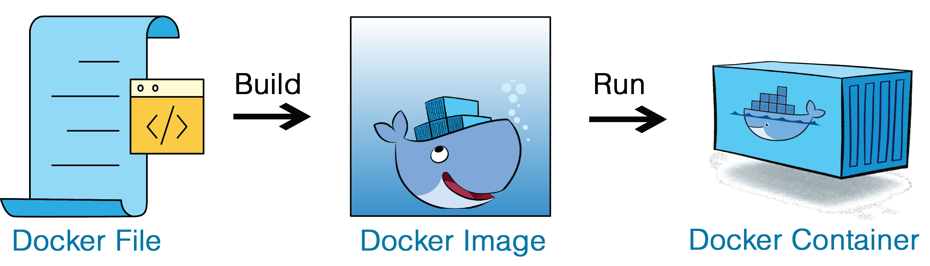
How containers are created?

Slide 31
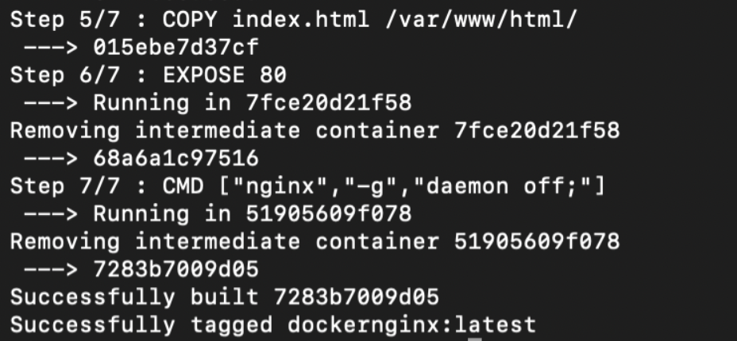
How containers are created?
Docker Build
docker build -t <name of tag of container> . ← . is to symbolize current directory.

Slide 32
Docker Commands Cheat Sheet

Slide 33
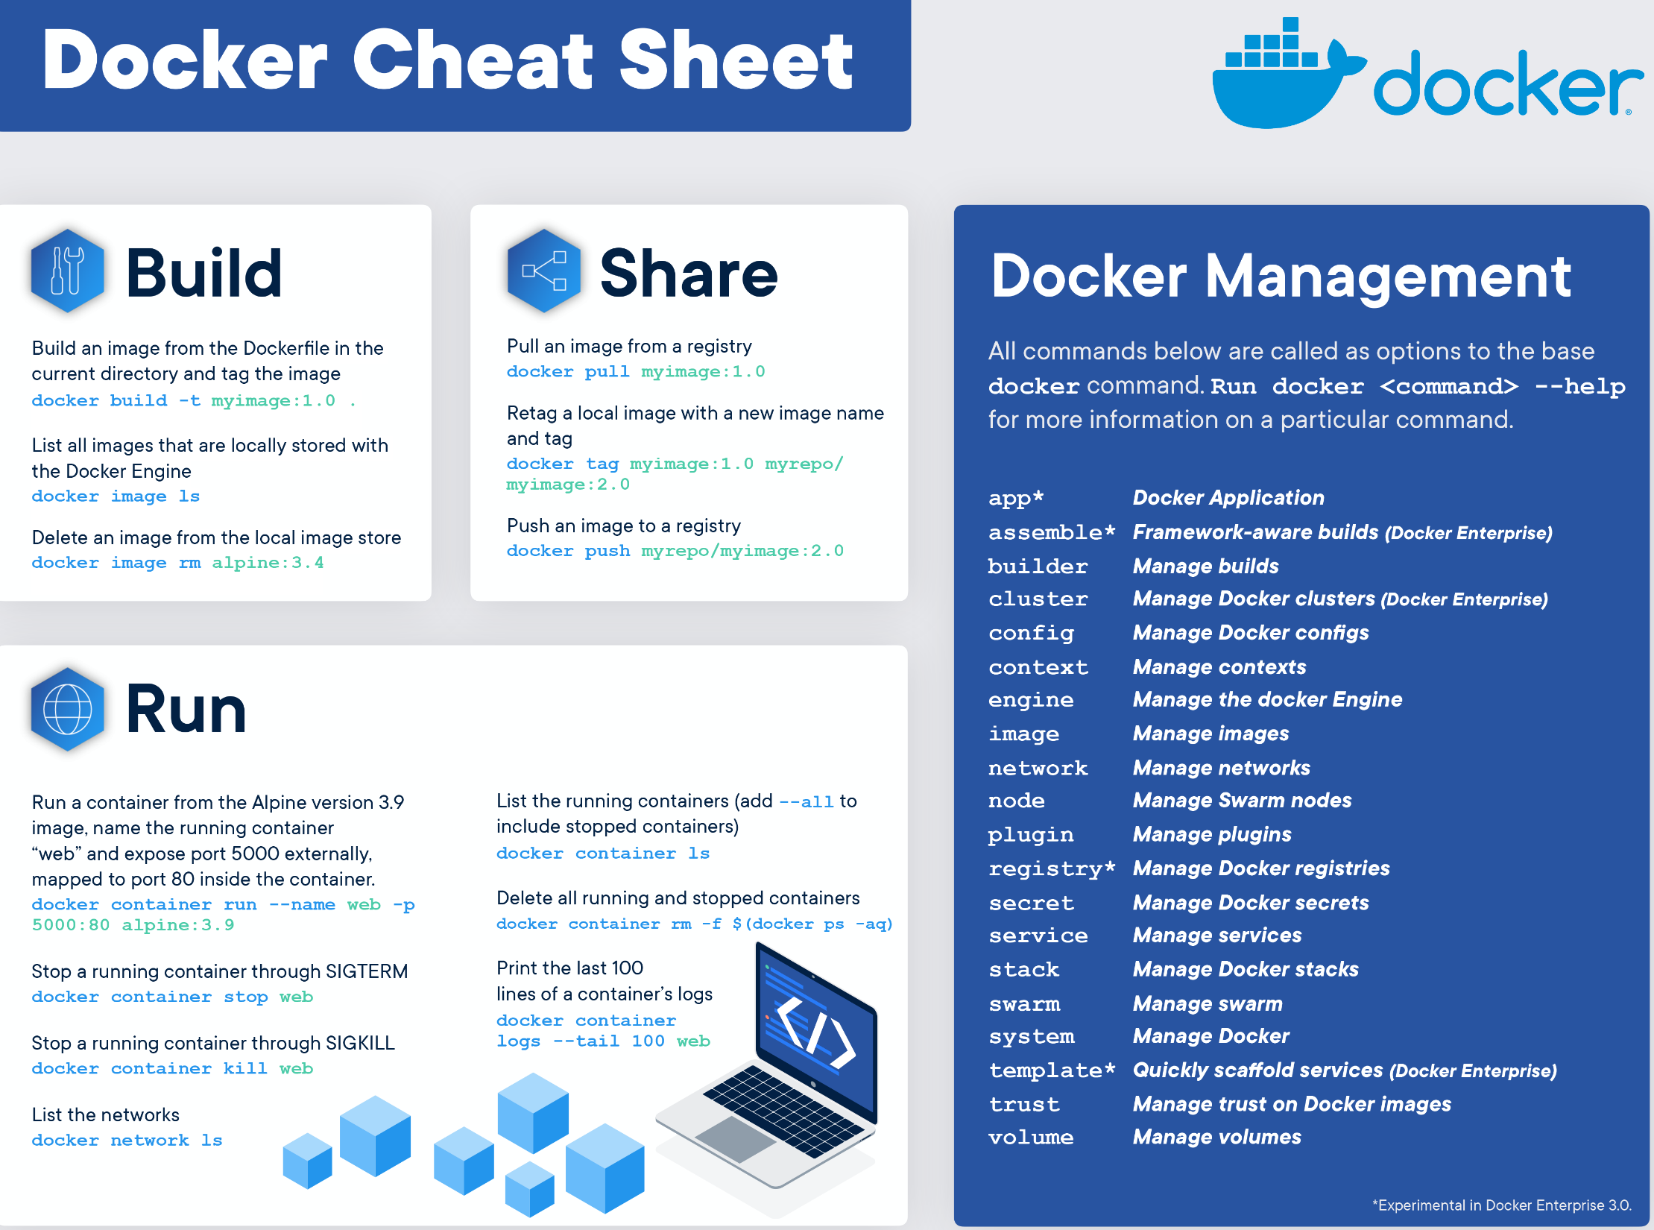

Slide 34
The End

